Slide 1
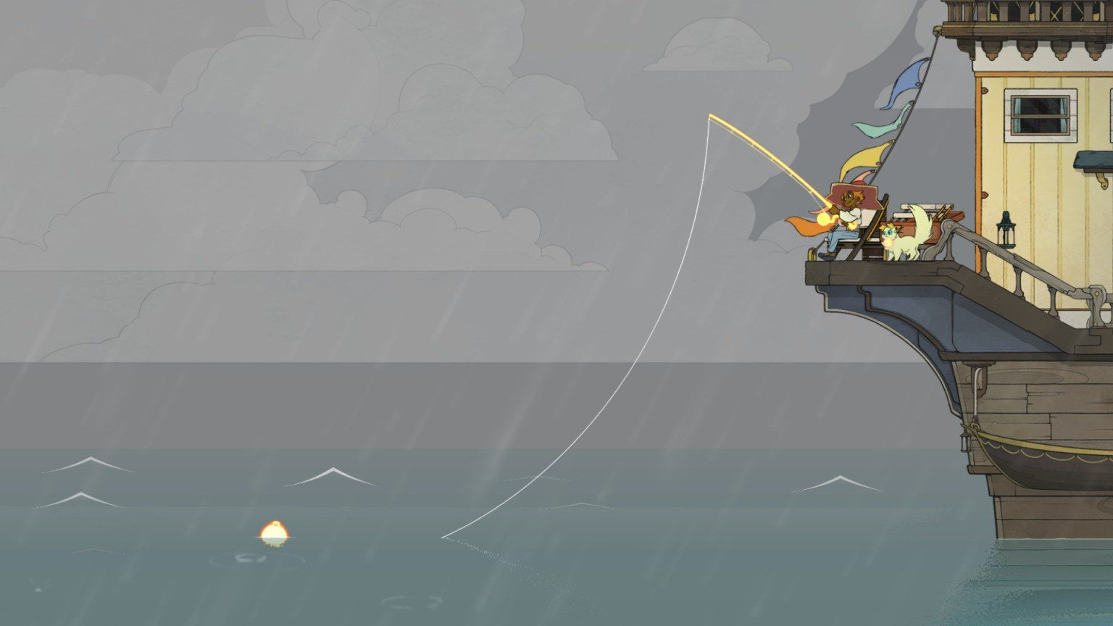
Ludonarrative
A Samuel Pottinger
Stat 198: IDSV
April 2, 2025

Slide 2
Today
We are going to be exploring the idea of how interaction creates narrative. To help start that conversation, I have a very short game for us to play:
https://www.necessarygames.com/play/loneliness/?q=my-games/loneliness/flash

Slide 3
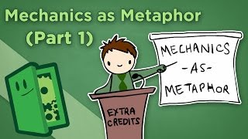
A consideration of mechanics and narrative

Slide 4
Introducing the idea of ludonarrative
Ludonarrative

Slide 5
Introducing the idea of ludonarrative
Ludonarrative

Slide 6
Introducing the idea of ludonarrative
Ludonarrative

Slide 7
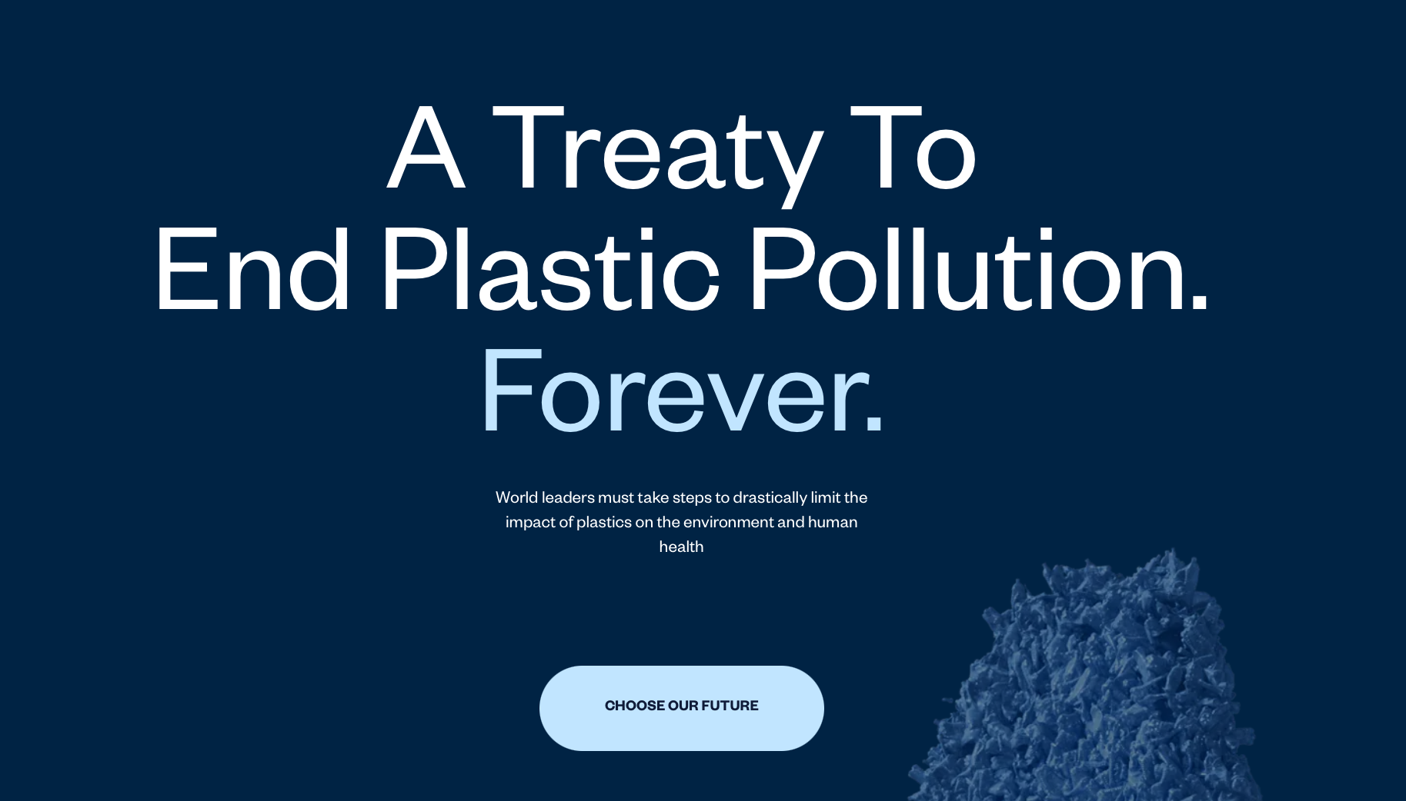
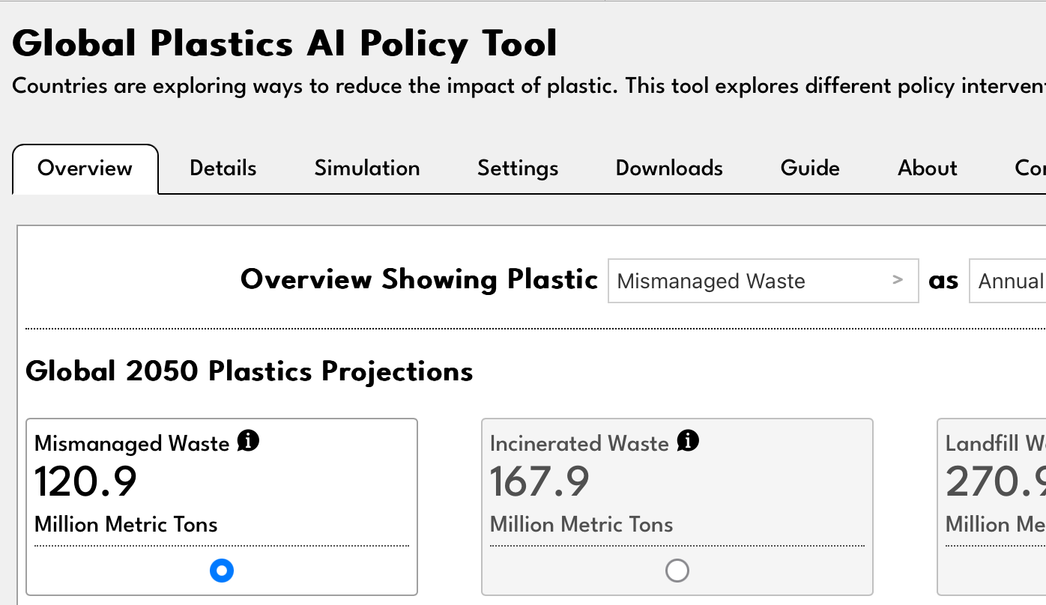
Ludonarrative in visualization
https://plasticstreaty.berkeley.edu/
https://global-plastics-tool.org/

Slide 8
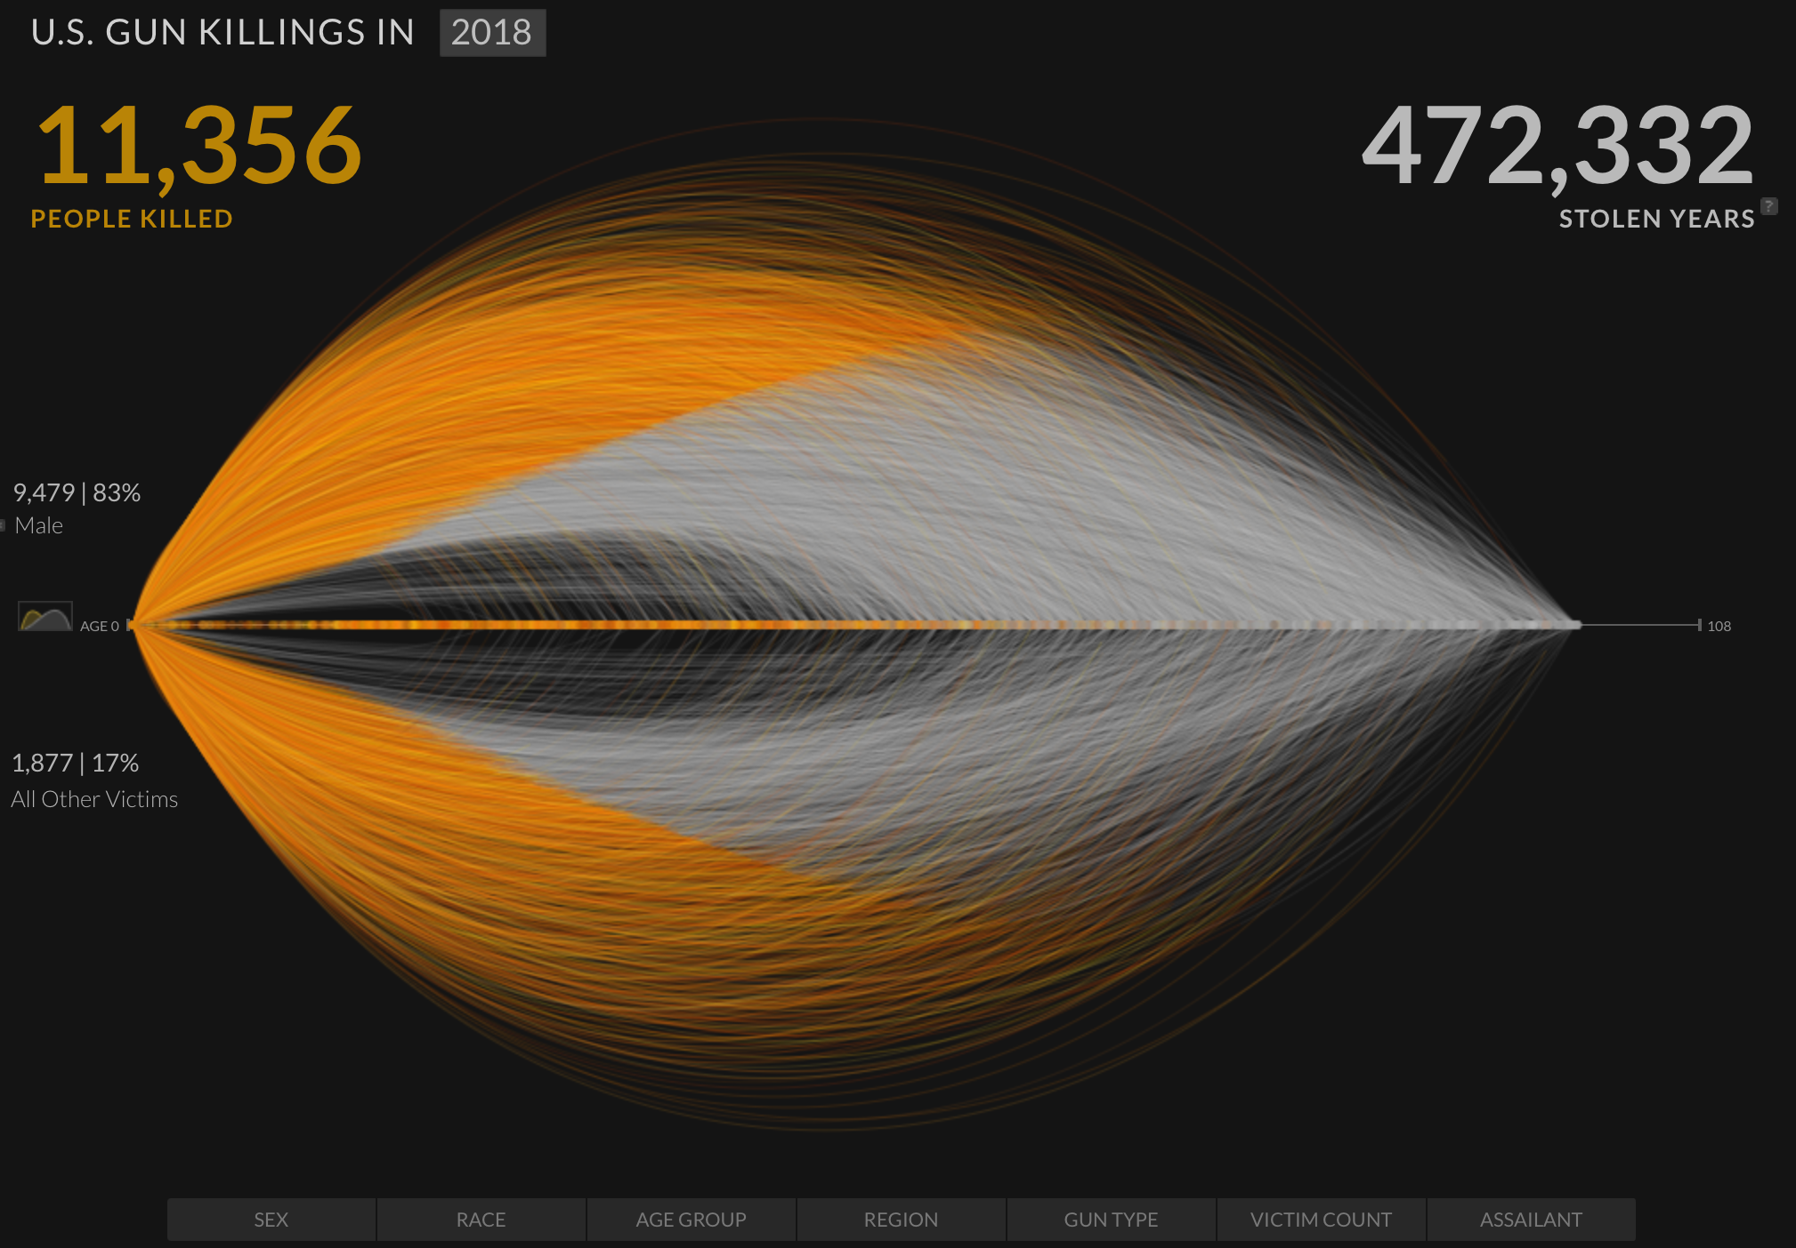
Translating the idea of environmental storytelling
https://guns.periscopic.com/

Slide 9
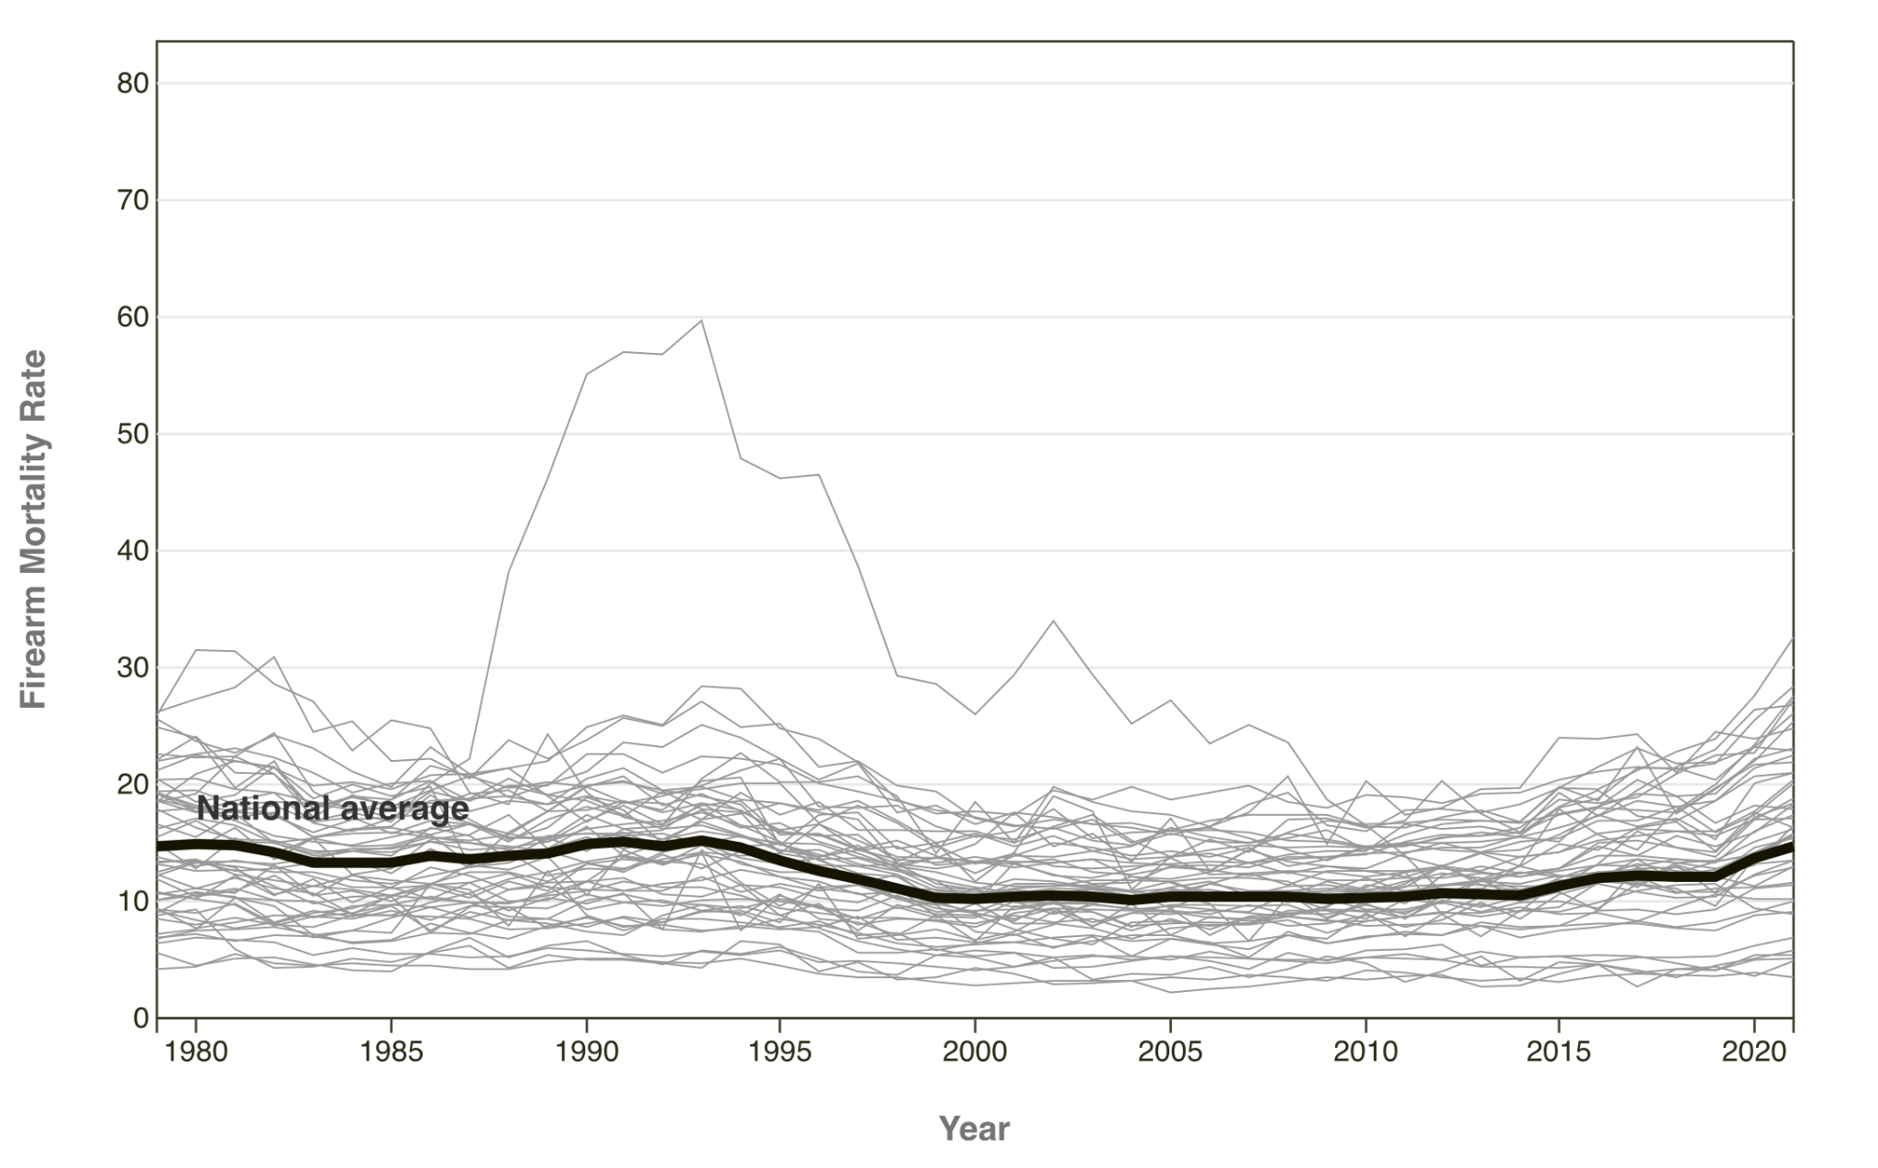
Translating the idea of environmental storytelling
https://www.rand.org/research/gun-policy/longitudinal-firearm-mortality.html

Slide 10
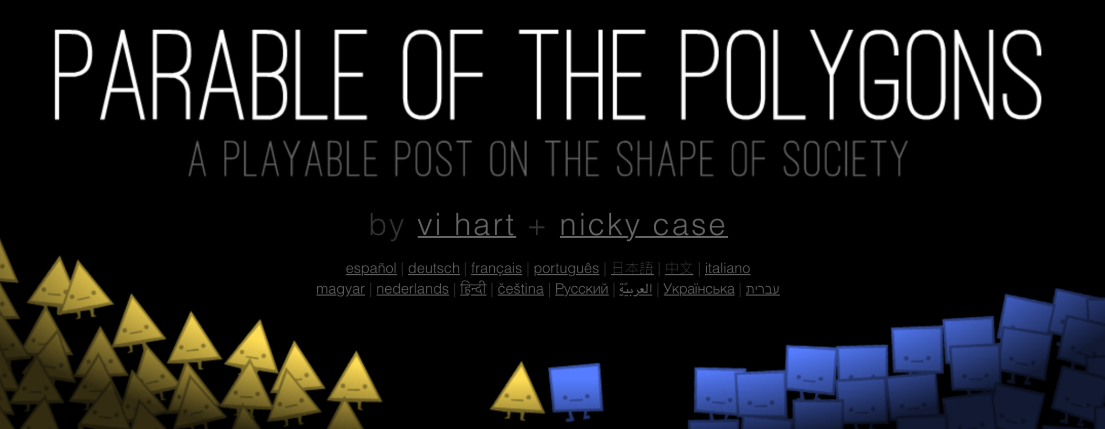
Tying it together
https://ncase.me/polygons/

Slide 11
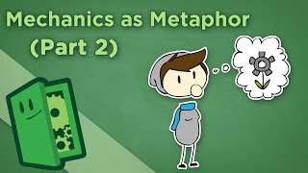
Concluding extra credits

Slide 12
Citations
A. Pottinger, R. Geyer, N. Biyani, C. Martinez, N. Nathan, M. Morse, M. de Bruyn, C. Boettiger, E. Baker, K. Koy, and D. McCauley, "Global Plastics AI Policy Tool," University of California, 2024. Available: https://global-plastics-tool.org/
A. Pottinger, R. Geyer, N. Biyani, C. Martinez, N. Nathan, M, Morse, C. Liu, S. Hu, M. de Bruyn, C. Boettiger, E. Baker, and D. McCauley, "Pathways to reduce global plastic waste mismanagement and greenhouse gas emissions by 2050," Science, 2024. doi: 10.1126/science.adr3837
G. Nicoli, "Spiritfarer: la morte felice," Ludica, 2020. Available: https://www.ludicamag.com/spiritfarer-la-morte-felice/
J. Portnow, "Mechanics as Metaphor I," Extra Credits, 2012. Available: https://www.youtube.com/watch?v=4QwcI4iQt2Y
A. Pottinger, R. Geyer, N. Biyani, C. Martinez, N. Nathan, M. Morse, M. de Bruyn, C. Boettiger, E. Baker, K. Koy, ThoughtLab, and D. McCauley, "Plastics Treaty," University of California, 2023. Available: https://plasticstreaty.berkeley.edu/
K. Reas and Periscopic, "U.S. Gun Killings in 2018," Periscopic, 2018. Available: https://guns.periscopic.com/
K. Sumah, L. Floyd, and H. McCracken, "Changes in State Firearm Mortality," Rand Corporation, 2024. Available: https://www.rand.org/research/gun-policy/longitudinal-firearm-mortality.html
V. Hart and N. Case, "Parable of the Polygons," Nicky Case, 2022. Available: https://ncase.me/polygons/

Slide 13


